Slide 1
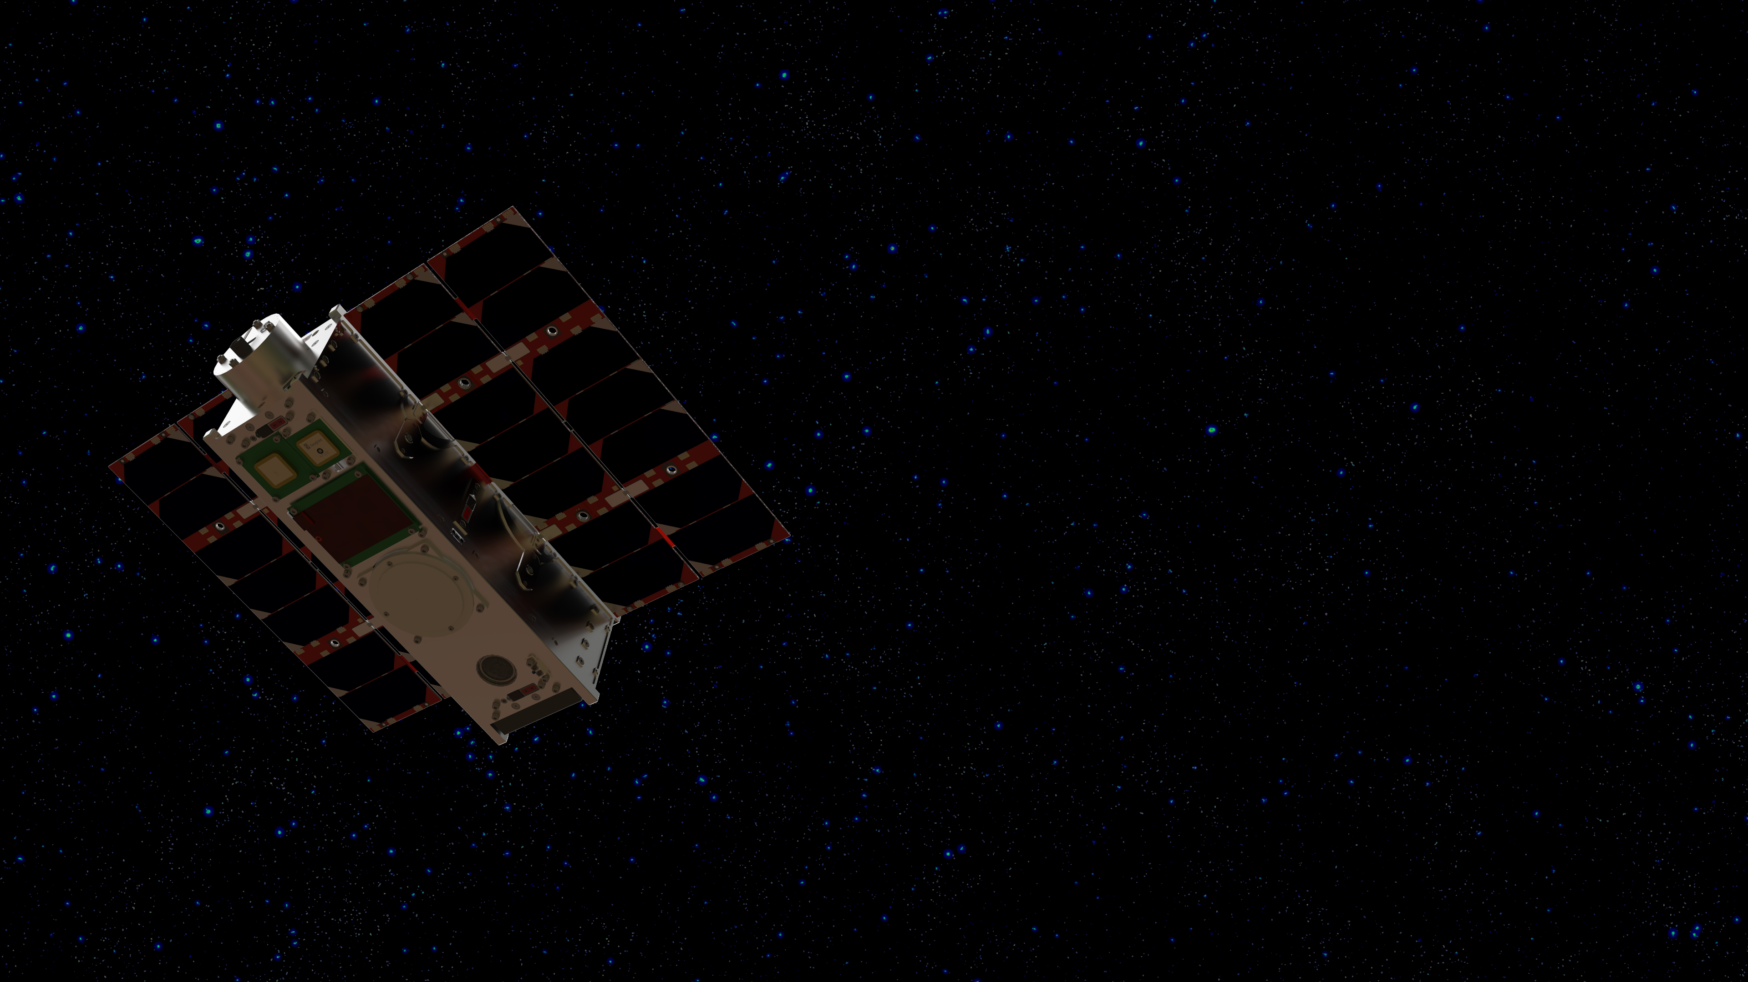
Looking at the Stars – Quantum Computing for Satellite Observation Planning
Project Work in Quantum Computing for Engineers
Kajetan,
Linus &
Philipp

Slide 2
Overview
The Problem
Classical and Quantum Approaches
Results

Slide 3
The Problem
Maximise observation time by reducing path lengths
Cost definition:
Mathematical description of TSP
Cycle starts and ends at the same city
All cities must be visited
The path length (number of edges) is equal to the number of cities
Notes:
Cost definition:
Can be multiple things for sattelite observation
Generally no
Mathematical description of TSP
Cycle starts and ends at the same city
All cities must be visited
The path length (number of edges) is equal to the number of cities

Slide 4
Classical Solution
Brute Force

Slide 5
Quantum Approach
Quantum Annealing, Grover Search
TSP is both a Combinatorial and a Unstructure
Notes:
TSP is a NP hard problem → a polynomial speedup is possible using quantum algorithms
TSP is both a combinatorial and an unstructured search problem → multitude of programms might achieve a speedup
Quantum Annealing:
uses quantum tunneling to find the global minimum of a cost function, which represents the shortest path in TSP.
Grover Search:
Grover’s algorithm offers a quadratic speedup for unstructured search problems and can be adapted to search for the optimal TSP route
However, an Oracle is needed that marks the valid solution → The Oracle needs to somehow solve TSP.
Since the main computational effort lies in adding up the costs it’s questionable if a gate-based oracle can achieve a significant speedup

Slide 6
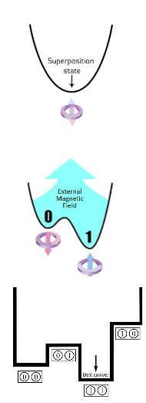
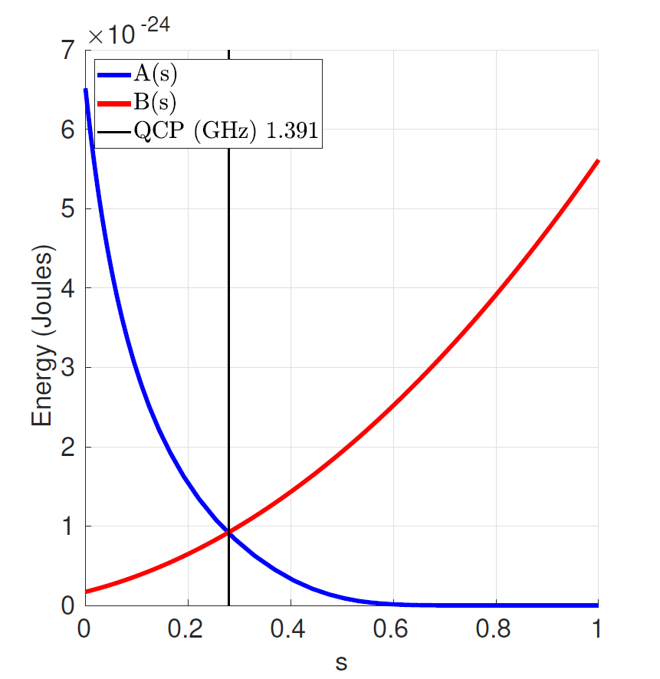
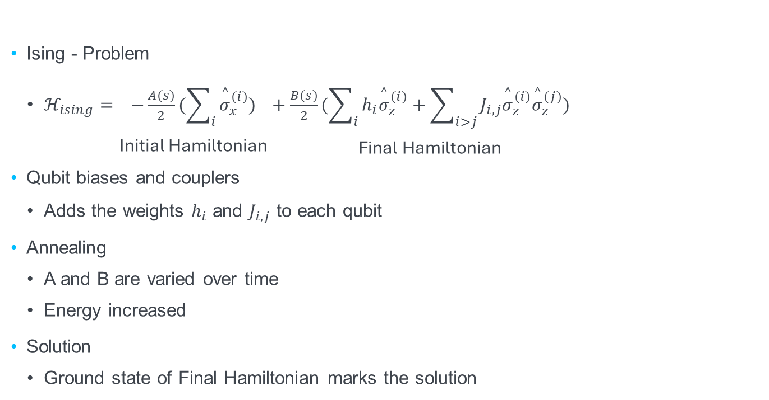
Quantum Annealing
In D-Wave QPUs
Ising - Problem
$ℋ_{ising}=\underset{\text{Initial} \text{Hamiltonian}}{\underset{}{−\frac{A(s)}{2}(\sum_{i}{{\overset{^}{σ}}_{x}^{(i)}})}}+\underset{\text{Final} \text{Hamiltonian}}{\underset{}{\frac{B(s)}{2}(\sum_{i}{h_{i}{\overset{^}{σ}}_{z}^{(i)}}+\sum_{i>j}{J_{i,j}{\overset{^}{σ}}_{z}^{(i)}{\overset{^}{σ}}_{z}^{(j)}})}}$
Qubit biases and couplers
Adds the weights $h_{i}$ and $J_{i,j}$ to each qubit
Annealing
A and B are varied over time
Energy increased
Solution
Ground state of Final Hamiltonian marks the solution
Notes:
Ising – Problem:
Two Hamiltonians are initialized.
The initial Hamiltonan puts all qubits through pauli gates in superposition (aequator on blochsphere)
The Final hamiltonian represents the problem that needs to be solved
Qubit biases and couplers
Adds the weights $h_{i}$ and $J_{i,j}$ to each qubit through externally applied Magneticfields
This forces the qubits into discrete (0 or 1) states
Annealing
A is decreased B is increased over time
→ Total Energy level first is increased by the Final Hamiltonian
By transitioning to lower states in the final Hamiltonian Enrgy is decreased
Solution
Ground state of Final Hamiltonian marks the solution this can be directly meassured
Quelle: D-Wave Systems

Slide 7
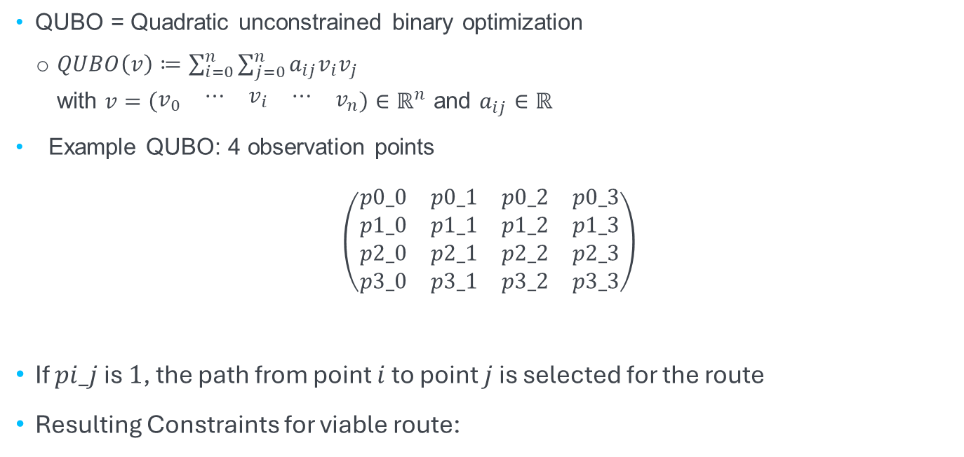
The first Quantum Annealing approach
How to formulate a QUBO function?
QUBO = Quadratic unconstrained binary optimization
$QUBO\left(v\right)≔\sum_{i=0}^{n}{\sum_{j=0}^{n}{a_{ij}v_{i}v_{j}}}$ with $v=\left(\begin{matrix}v_{0} & \begin{matrix}⋯ & v_{i} & ⋯\end{matrix} & v_{n}\end{matrix}\right)∈ℝ^{n}$ and $a_{ij}∈ℝ$
Example QUBO: 4 observation points
$$\left(\begin{matrix}p0_0 & p0_1 & p0_2 & p0_3 \\ p1_0 & p1_1 & p1_2 & p1_3 \\ p2_0 & p2_1 & p2_2 & p2_3 \\ p3_0 & p3_1 & p3_2 & p3_3\end{matrix}\right)$$
If $pi_j$ is $1$, the path from point $i$ to point $j$ is selected for the route
Resulting Constraints for viable route:
Notes:
QUBO: is a function of an arbitrary amount of variables
Each term must contain a product of two variables, or a square of a single variable and some real factor
Quantum Annealing will minimize this function

Slide 8

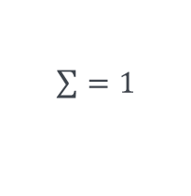
The first Quantum Annealing approach
How to formulate a QUBO function?
$$\left(\begin{matrix}p0_0 & p0_1 & p0_2 & p0_3 \\ p1_0 & p1_1 & p1_2 & p1_3 \\ p2_0 & p2_1 & p2_2 & p2_3 \\ p3_0 & p3_1 & p3_2 & p3_3\end{matrix}\right)$$
Resulting Constraints for viable route:
$\sum{=1}$
Notes:
QUBO: is a function of an arbitrary amount of variables
Each term must contain a product of two variables, or a square of a single variable and some real factor
Quantum Annealing will minimize this function

Slide 10
Our Results

Slide 11


Slide 12
Any questions?

